Slide 1
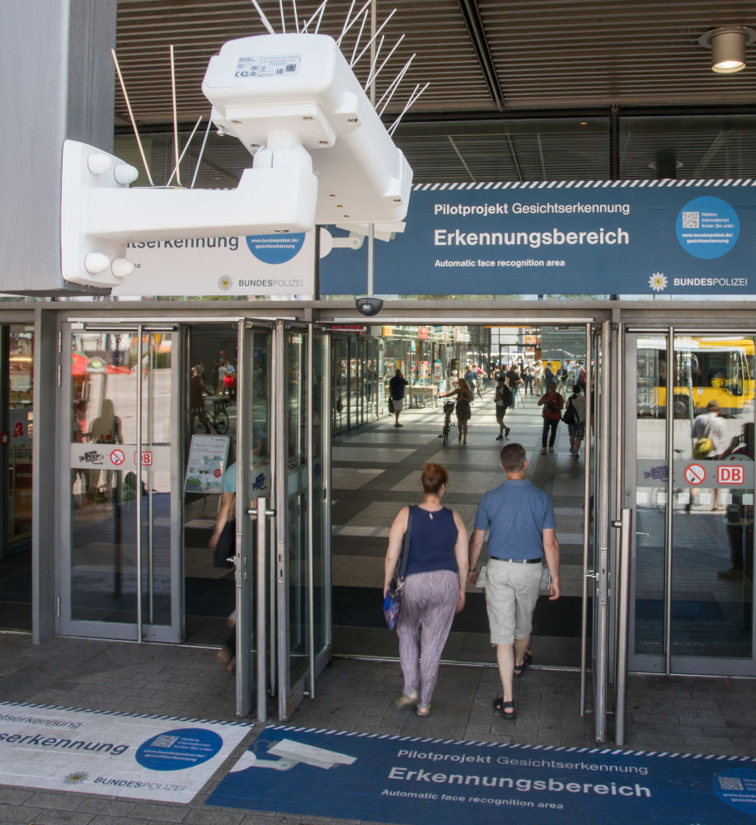
NS Face Recognition Checkin Checkout

Slide 2

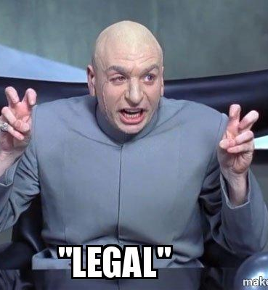

Slide 3
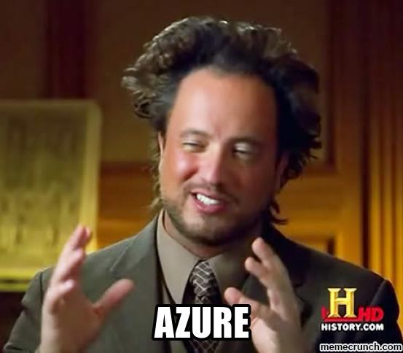
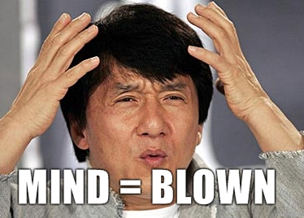

Slide 4
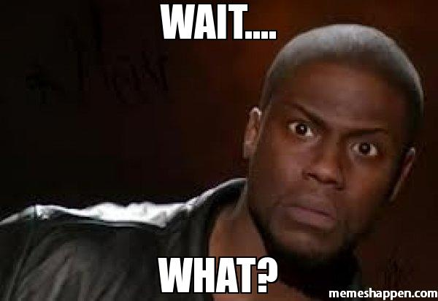
Context
NS -> “ Hey Krish can you show something awesome in Azure”
Krish -> “ Definitely yes ☺ but what specifcally ?”
NS -> “ No clue, but you guys are saying Azure is awesome for a year now so show us some Awesomeness”
Krish-> “Kaushik Can you show someting Awesome”
Kaushik -> “Sure But like what ? “
Krish-> “No idea dude NS asked us to show something Awesome”

Slide 5

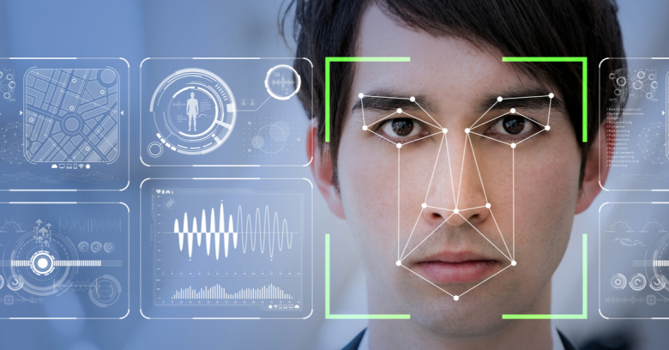
Predictive maintenance
Face Recognition

Slide 6
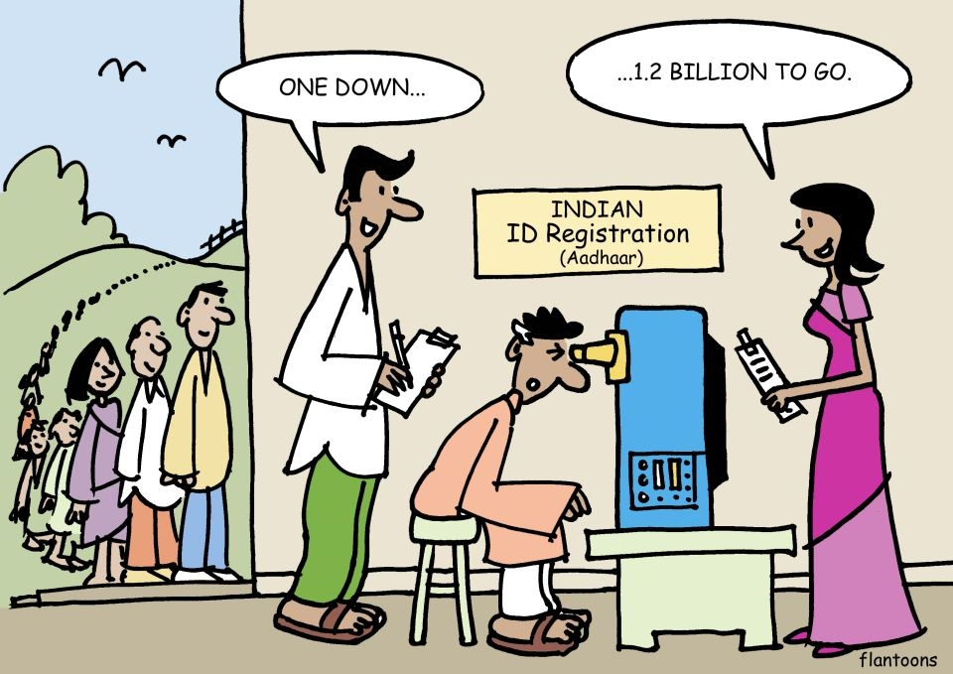
So whats the Plan ?
Facial scanning
Person uID
Identify the Person and Status
person status
Update State
Matched
Proceed to Checkin/Checkout
Partially Matched
Unmatched
Manual Checkin/Checkout
Train Facial Model
Face Image
Registration
Face Image
Create person Status

Slide 7
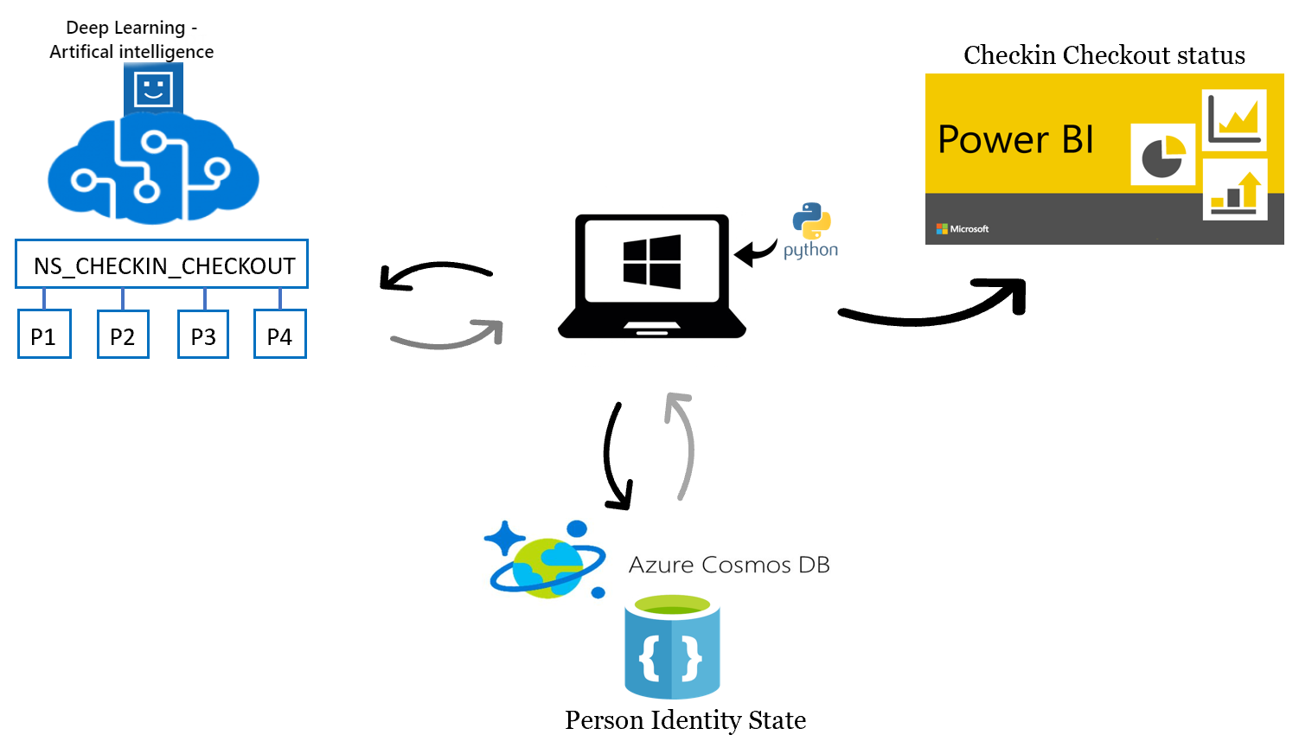
Architecture – Finally something that makes sense

Slide 8
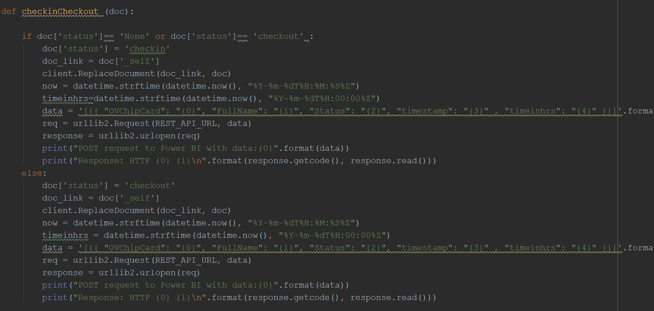
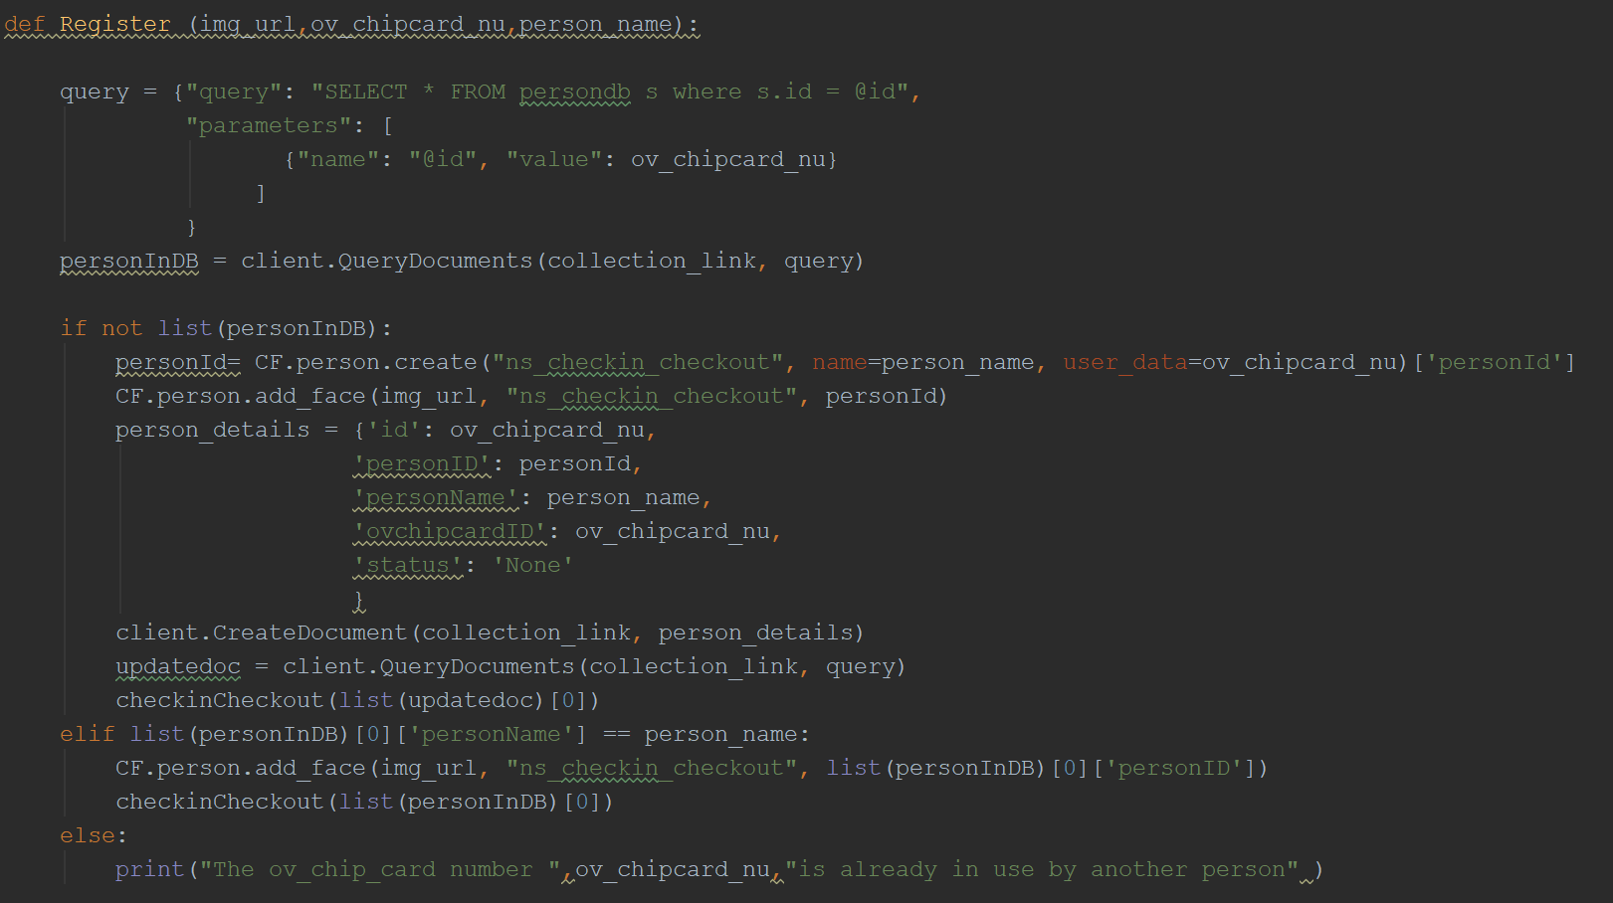
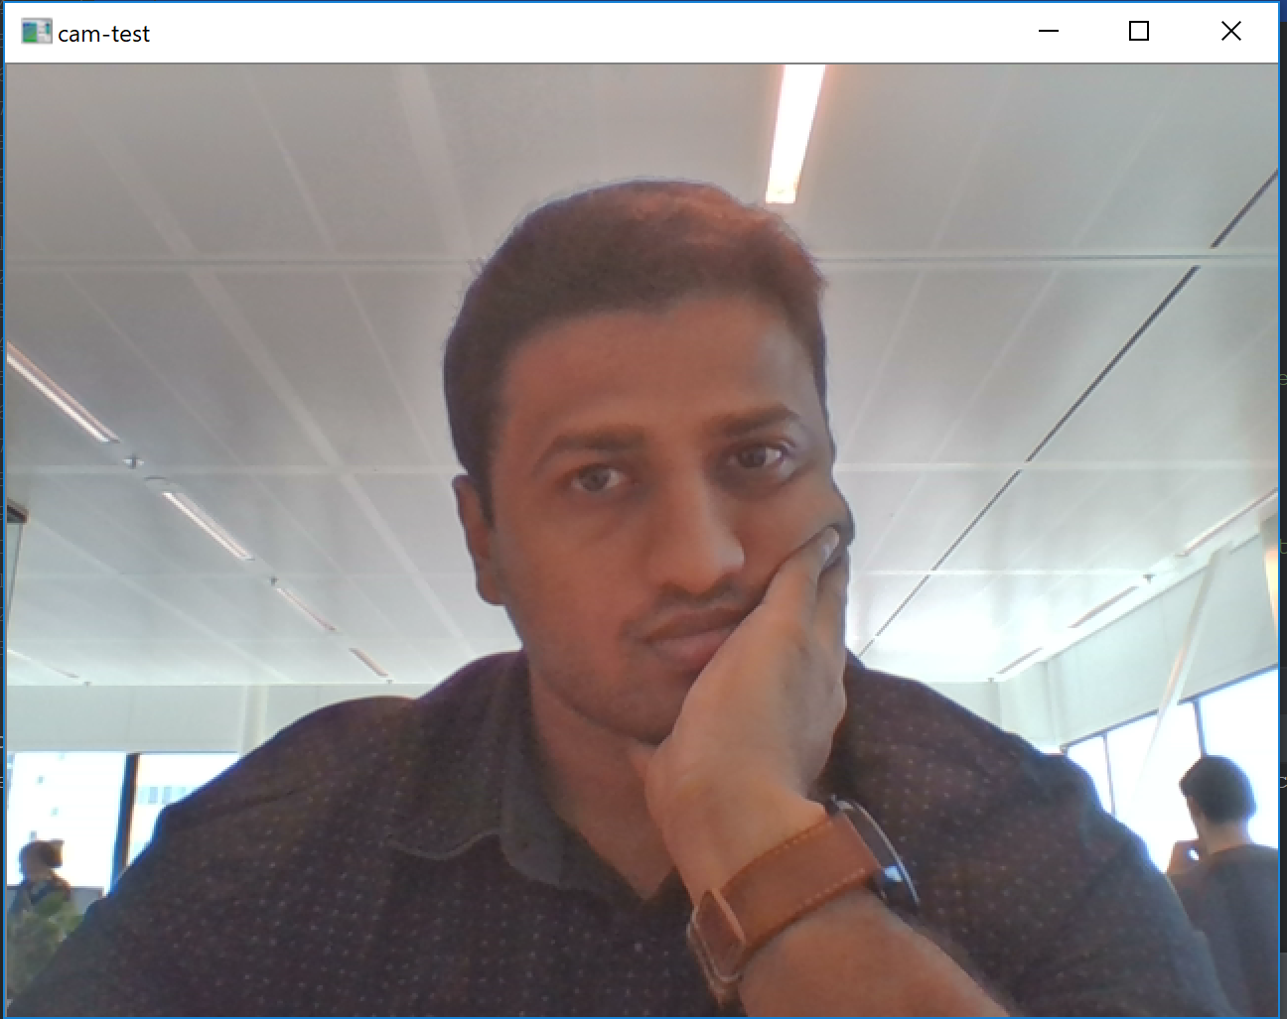
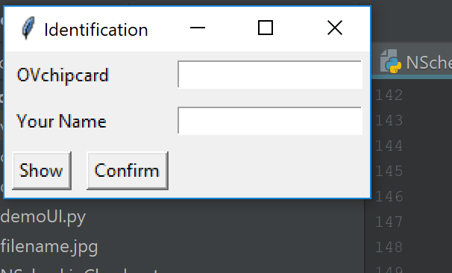
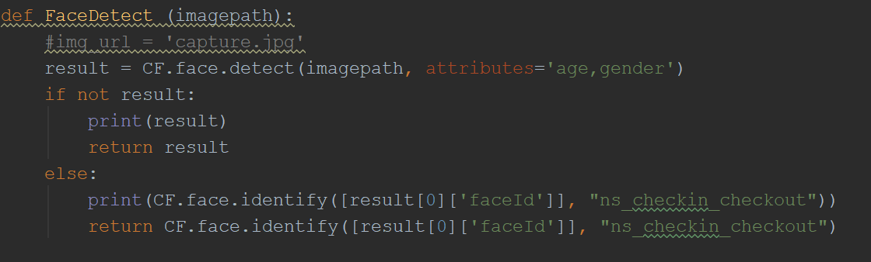
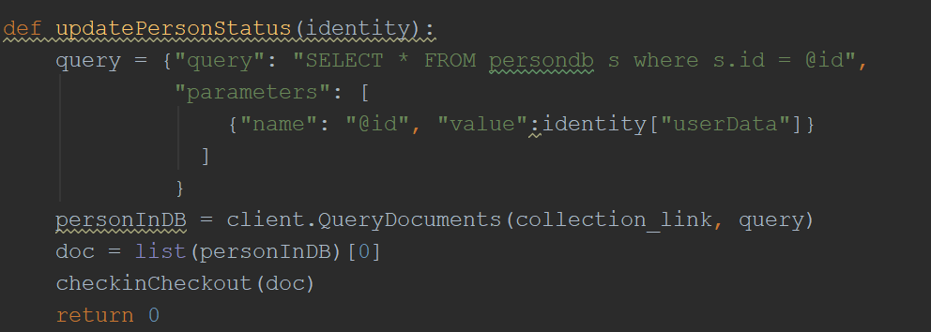
Believe me I did something

Slide 9
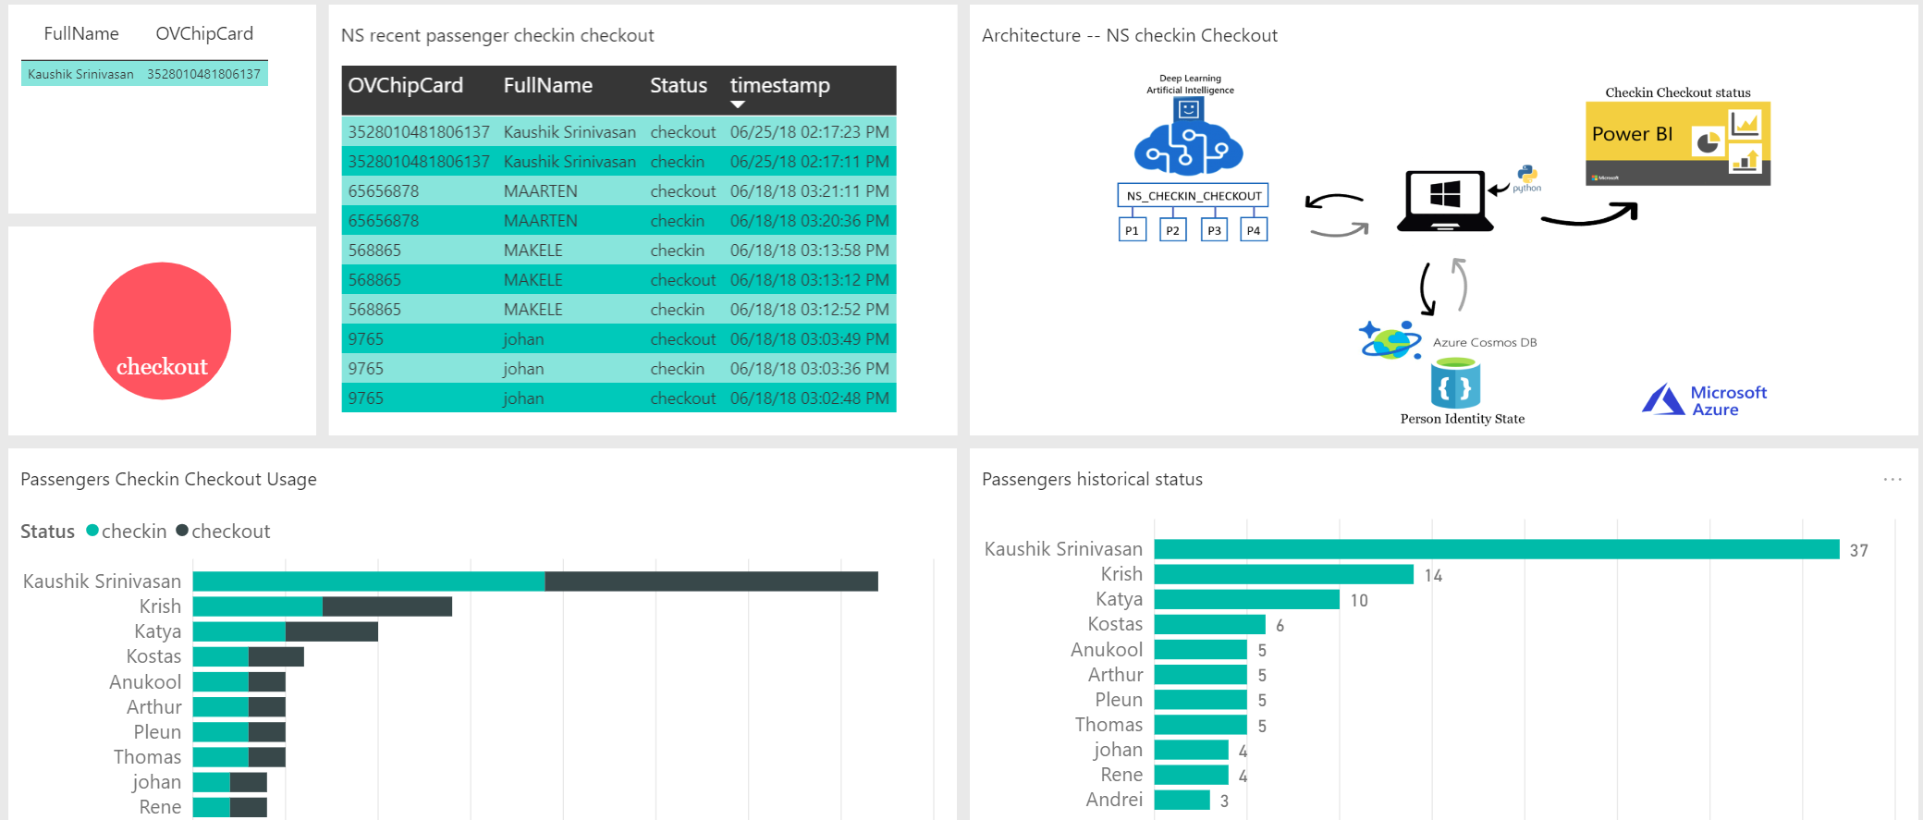
PowerBI to the rescue

Slide 10



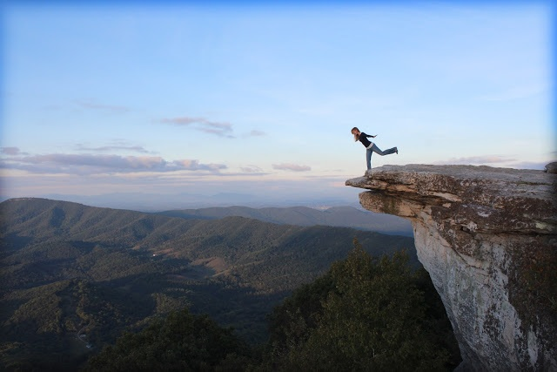
What if moment
IoT edge BTW

Slide 11
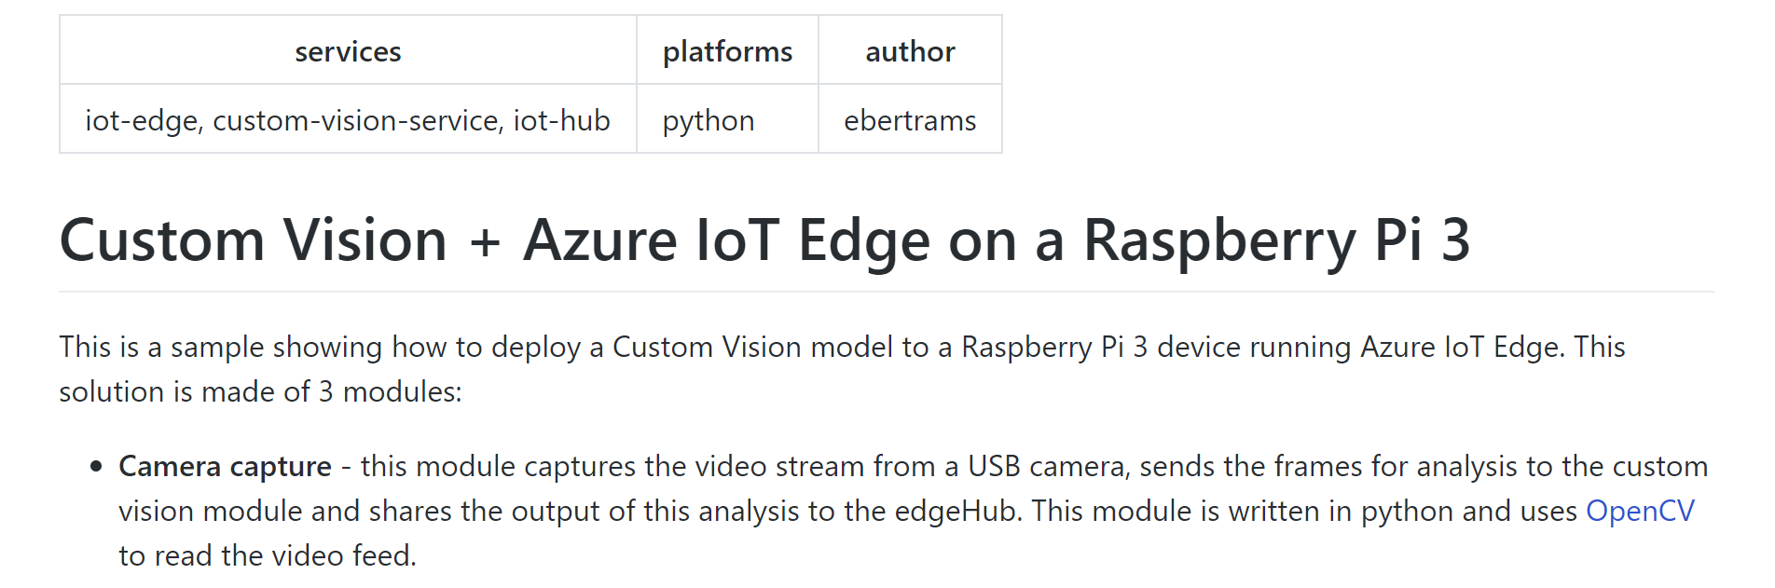
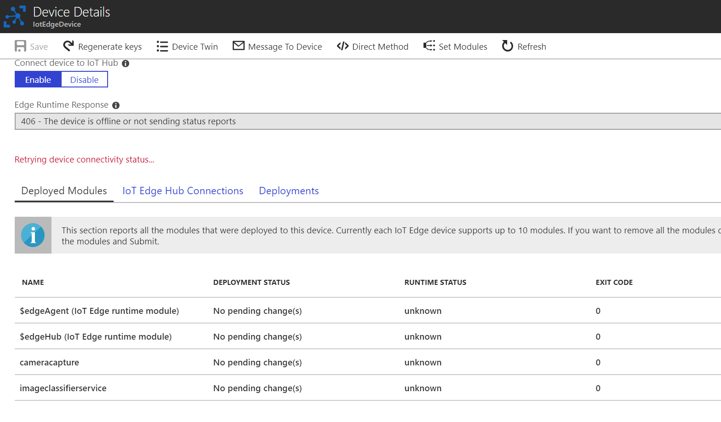
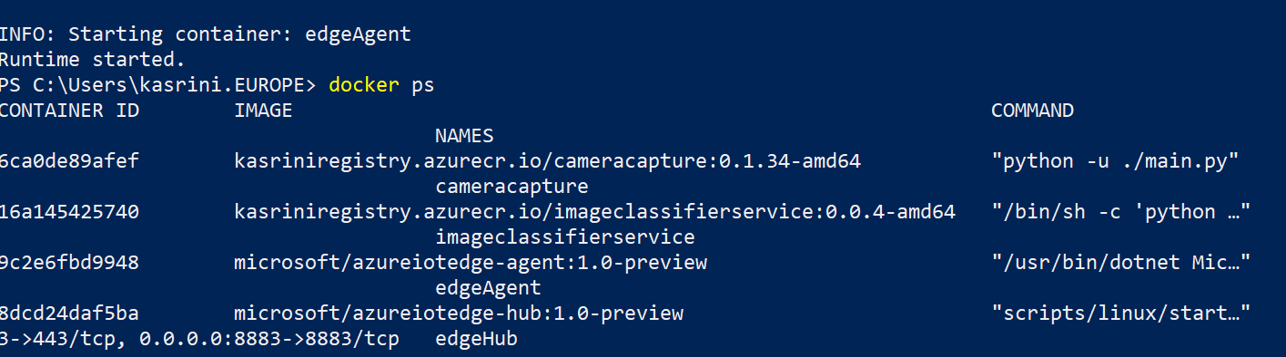
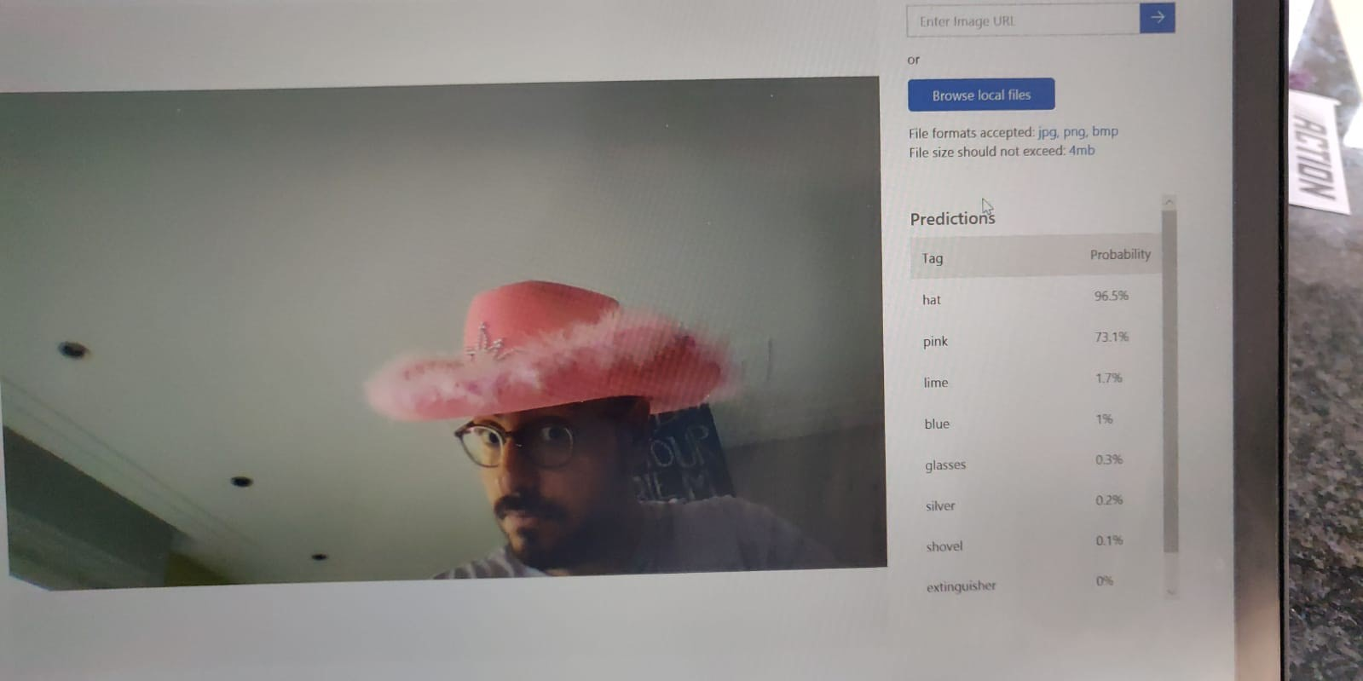
Tadaaaaaaaaa

Slide 12
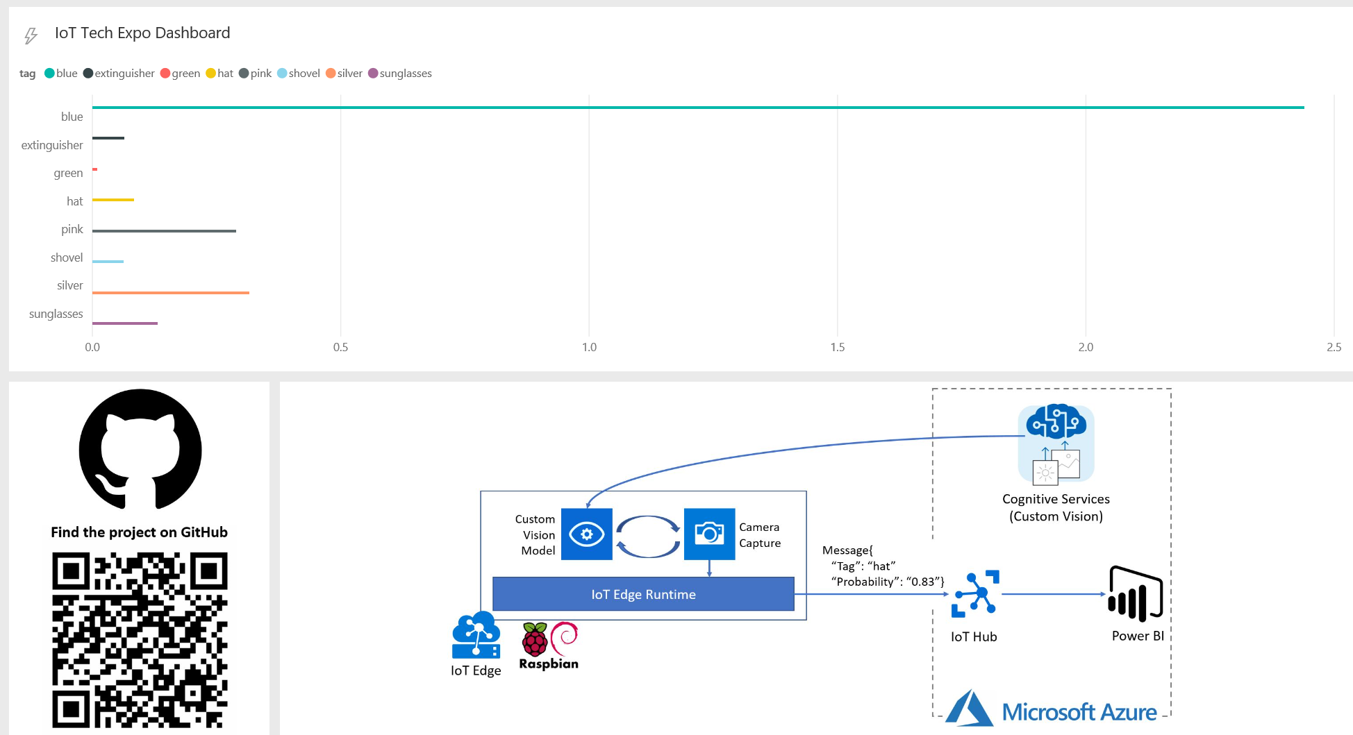
Tadaaaaaaaaa 2

Slide 13
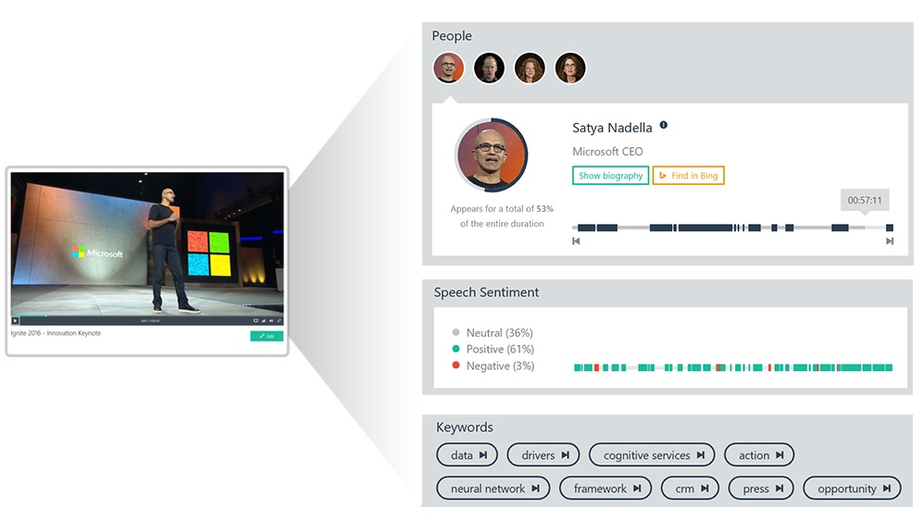
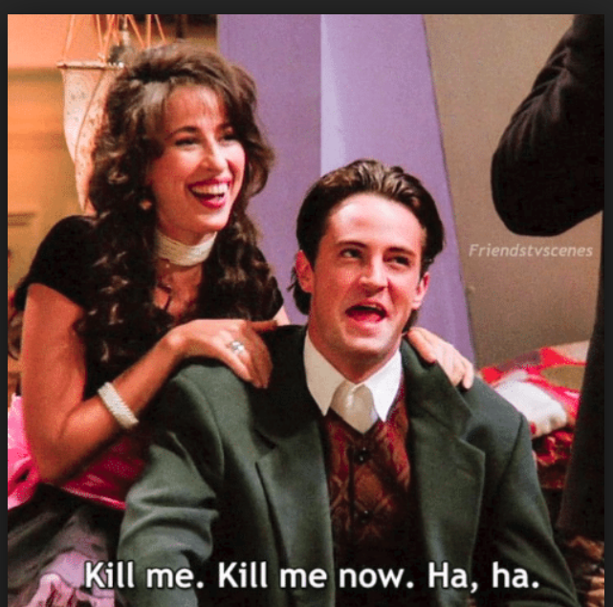
Verdict – After All This ?
The Video Indexer demo Won the hearts

Slide 14


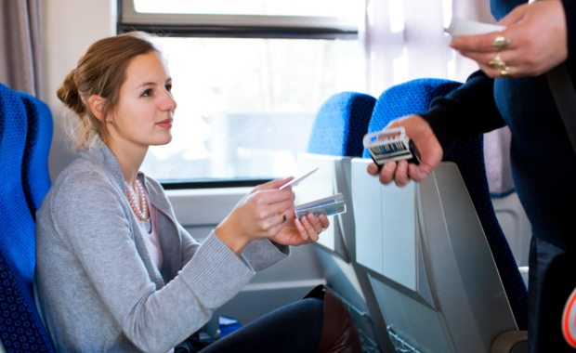
But So did Face recognition Checkin Checkout

Slide 15
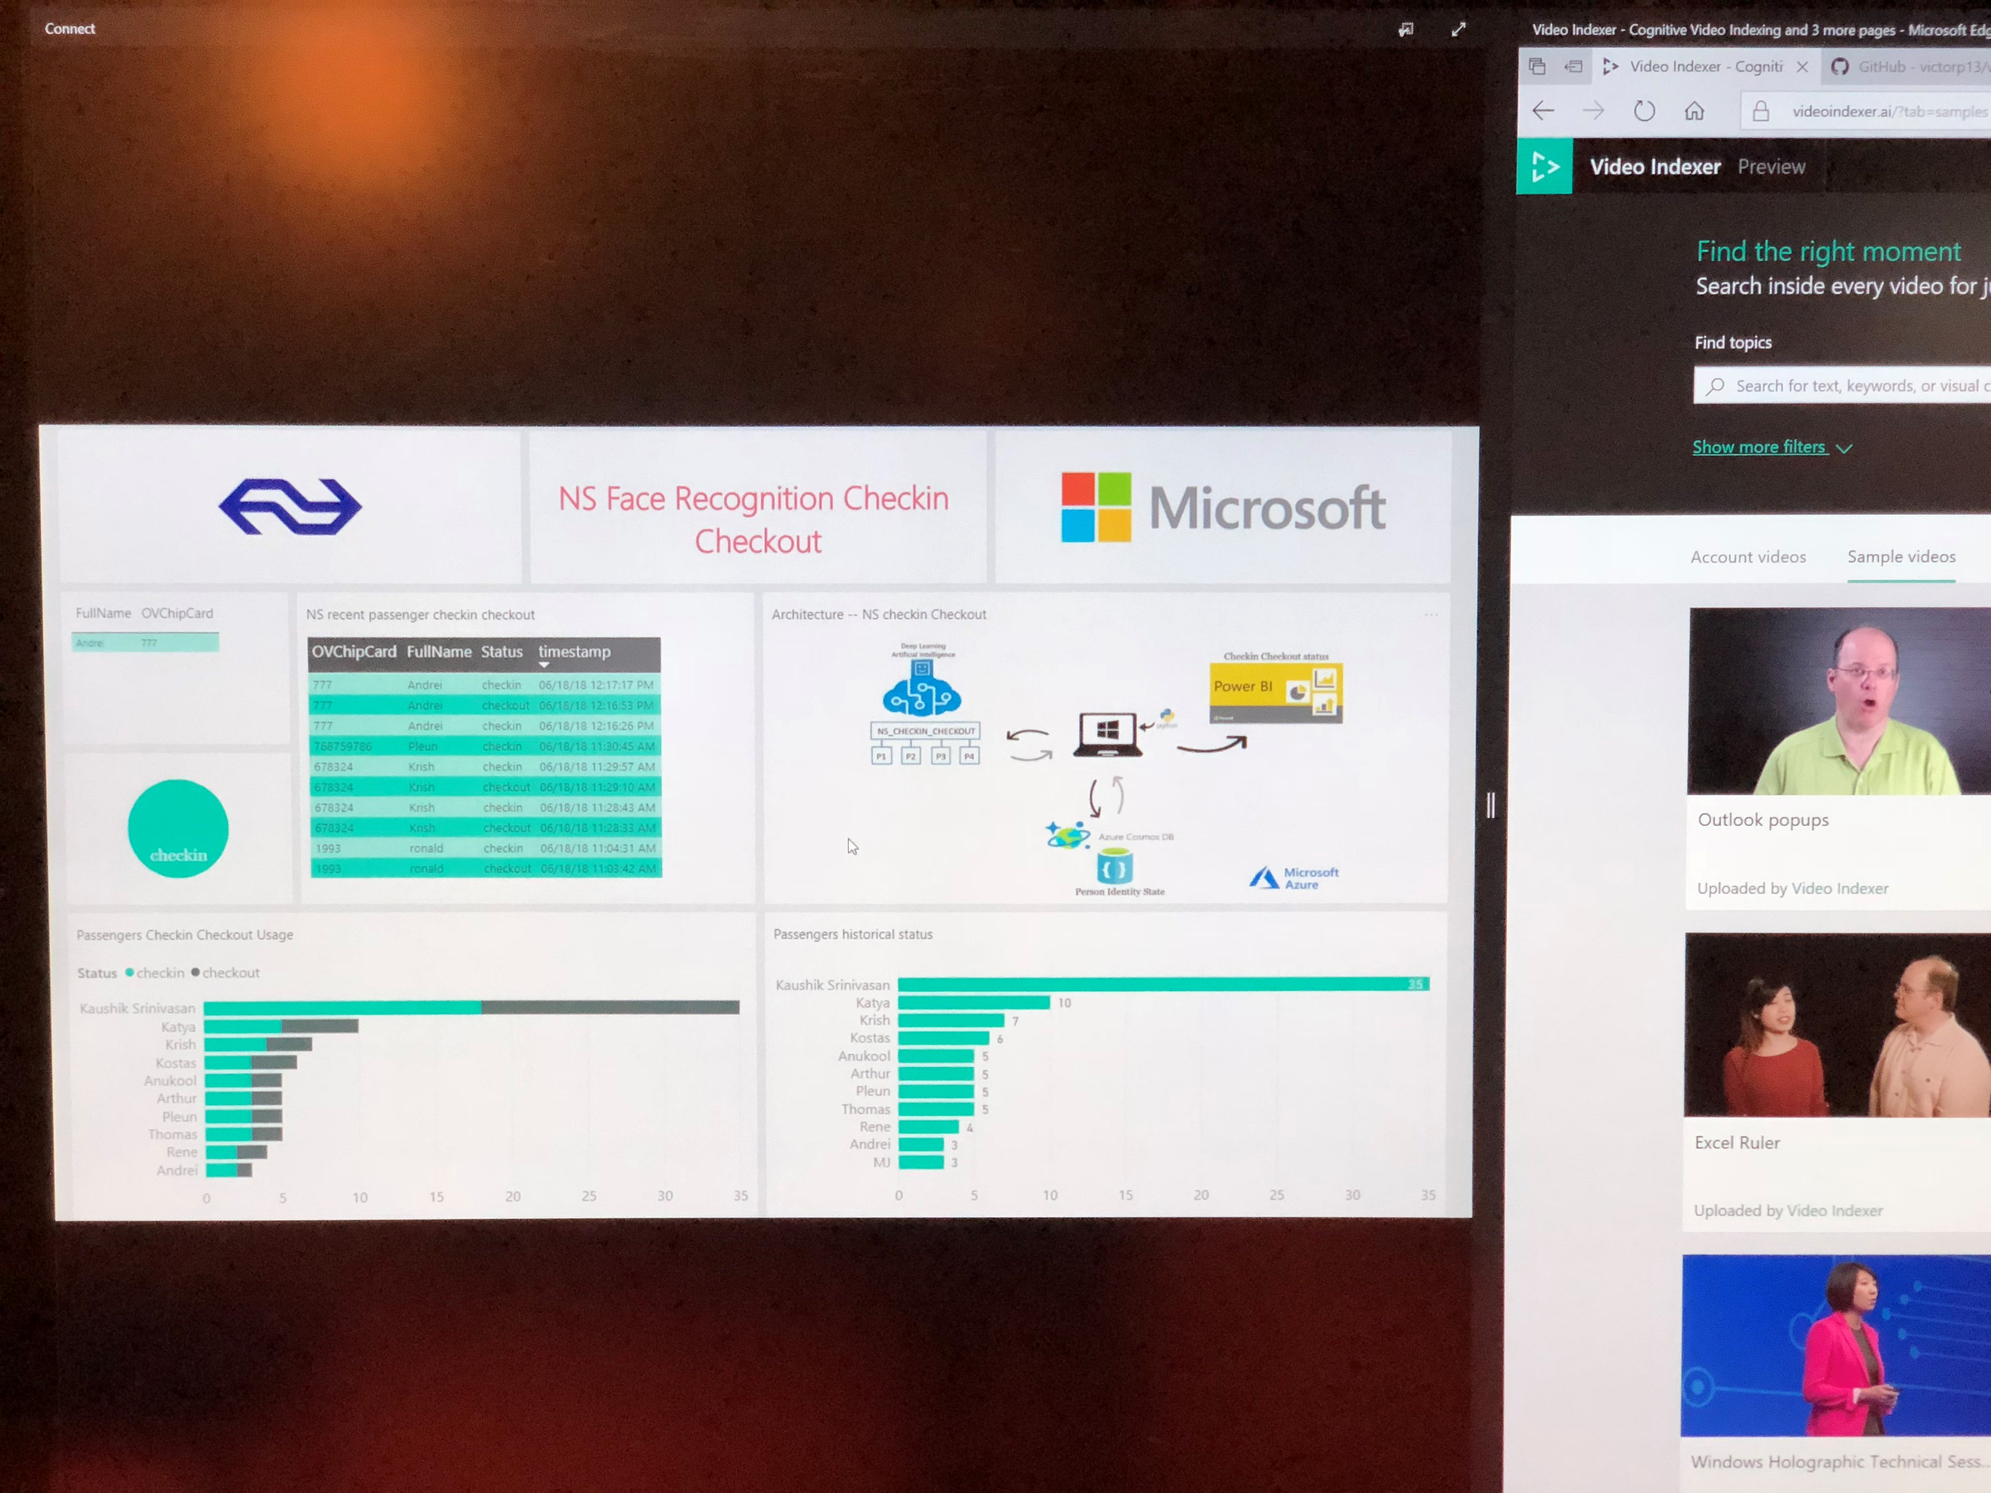
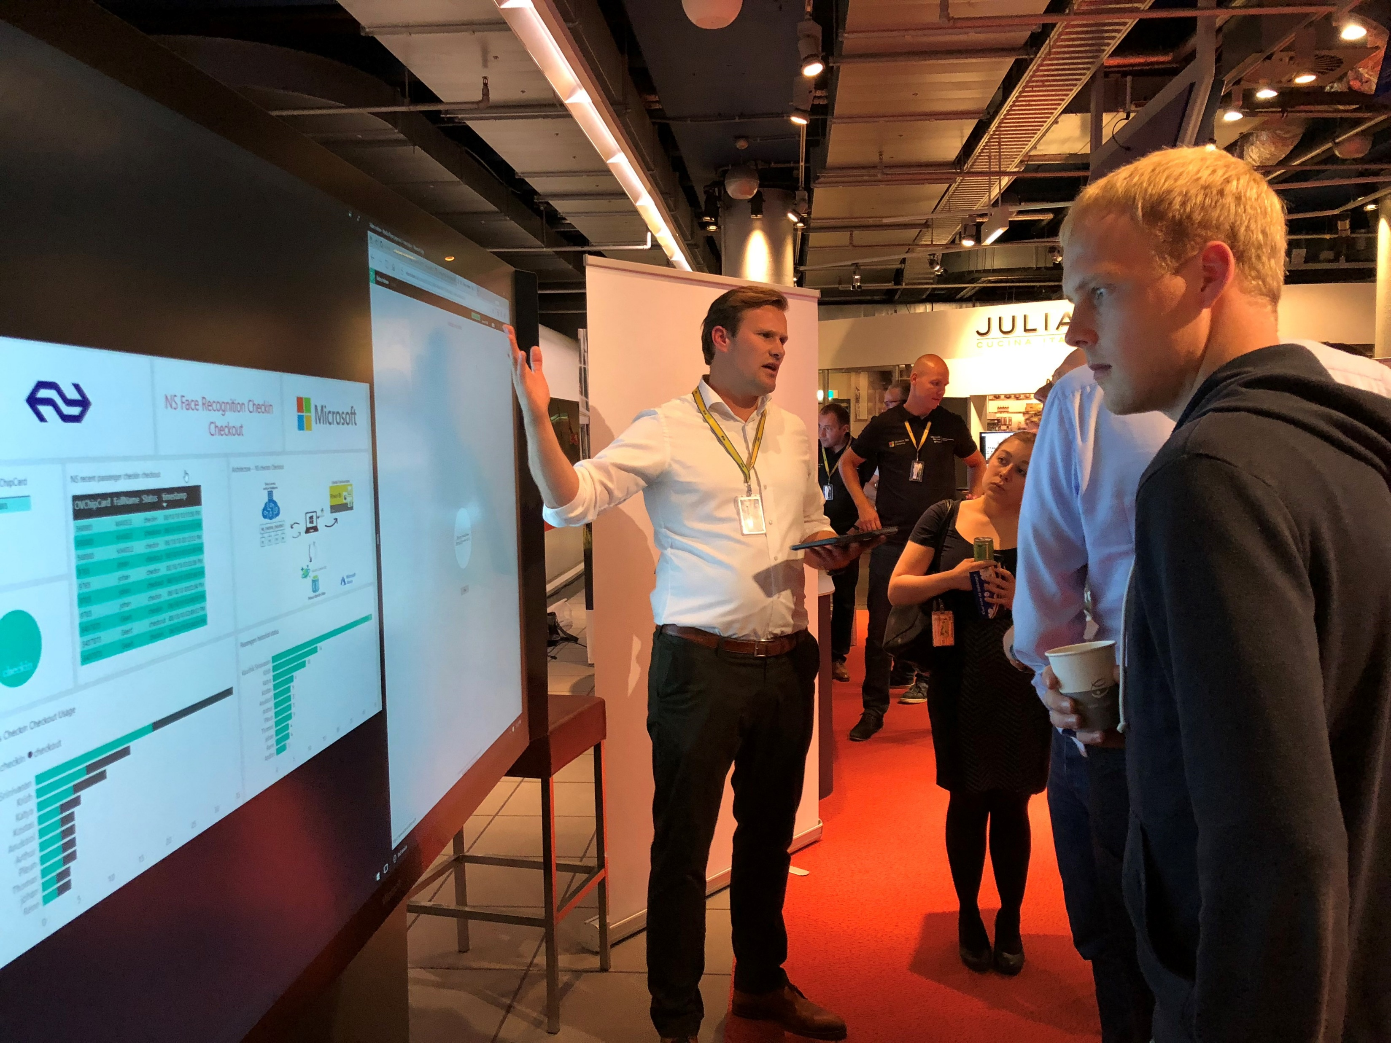
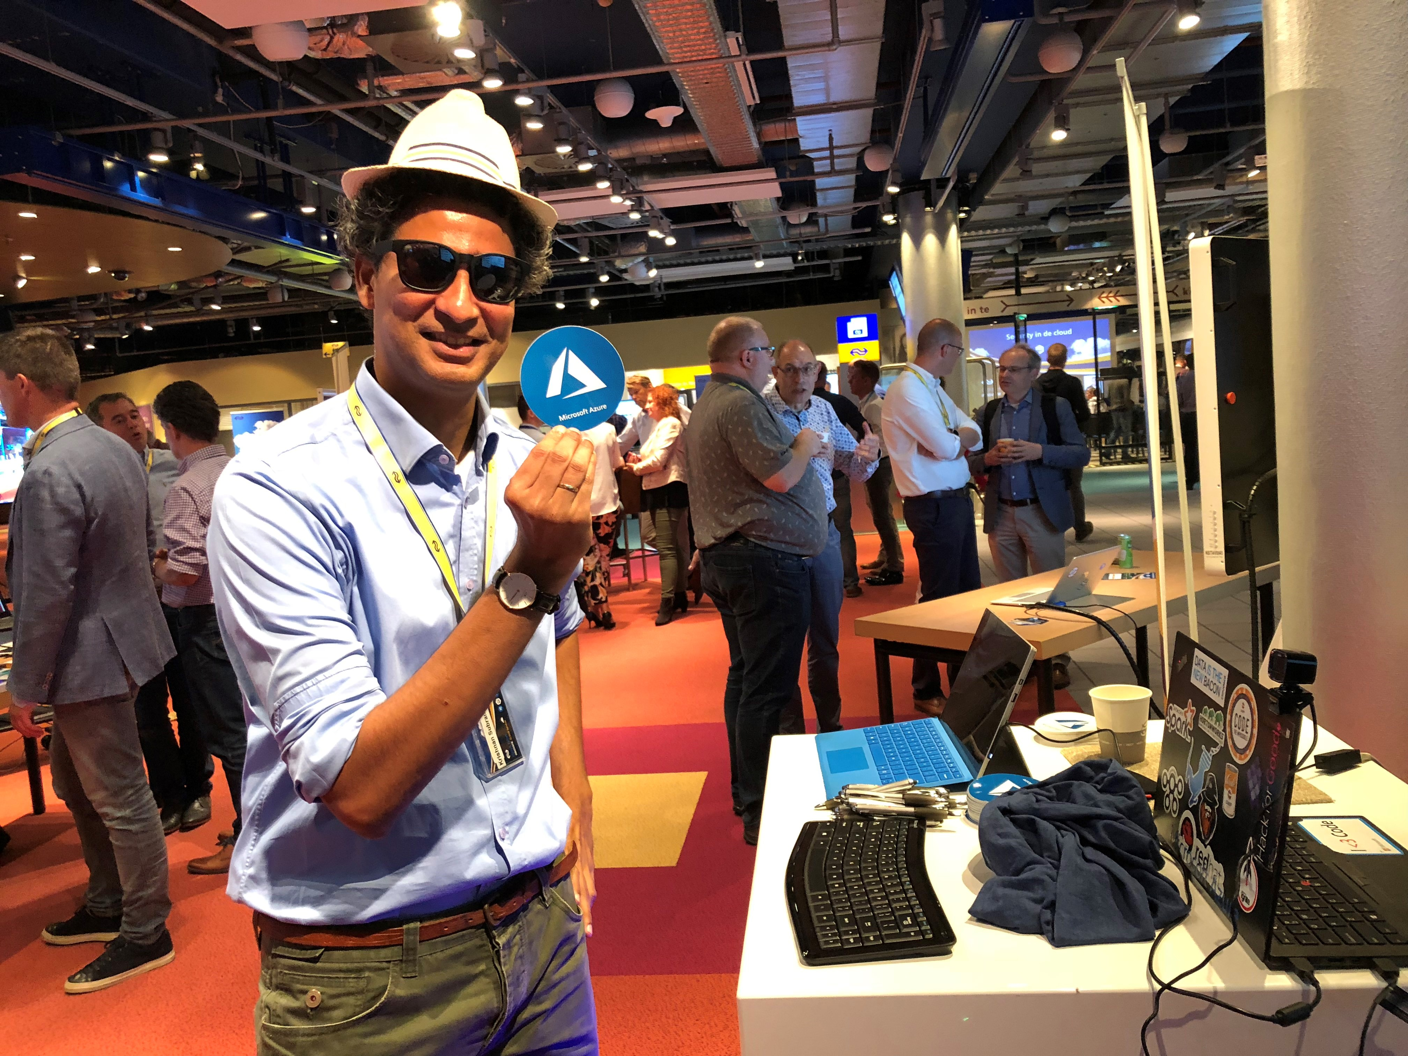
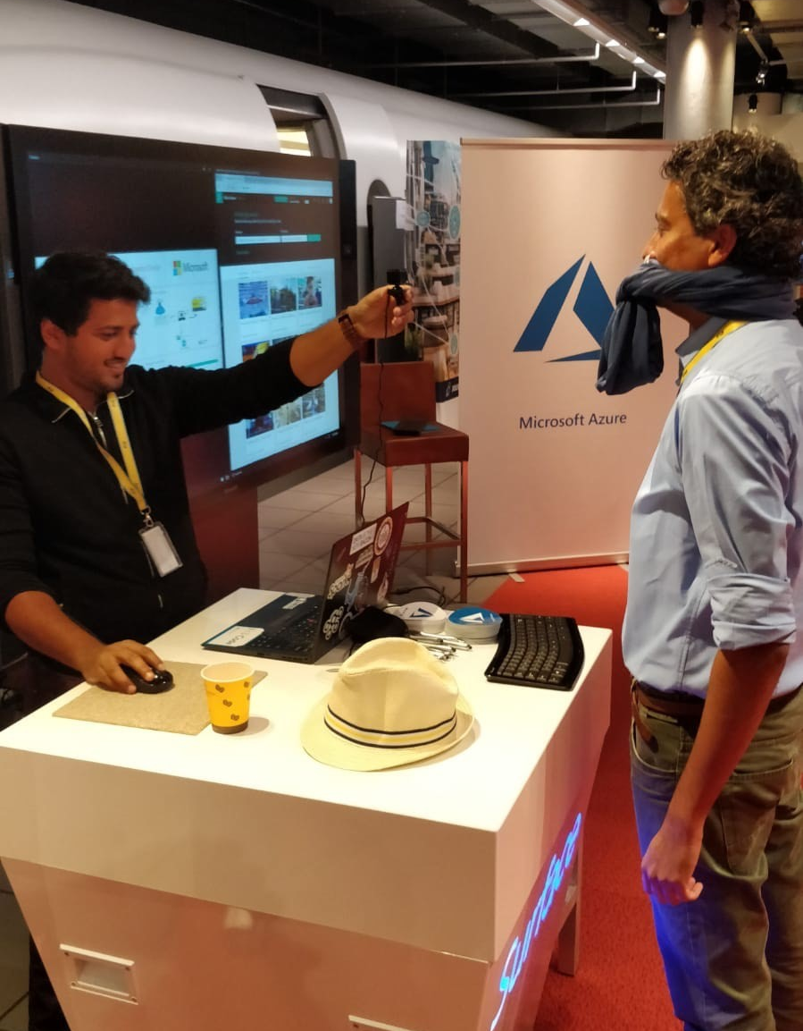
Let’s make Azure Great again ☺

Slide 16
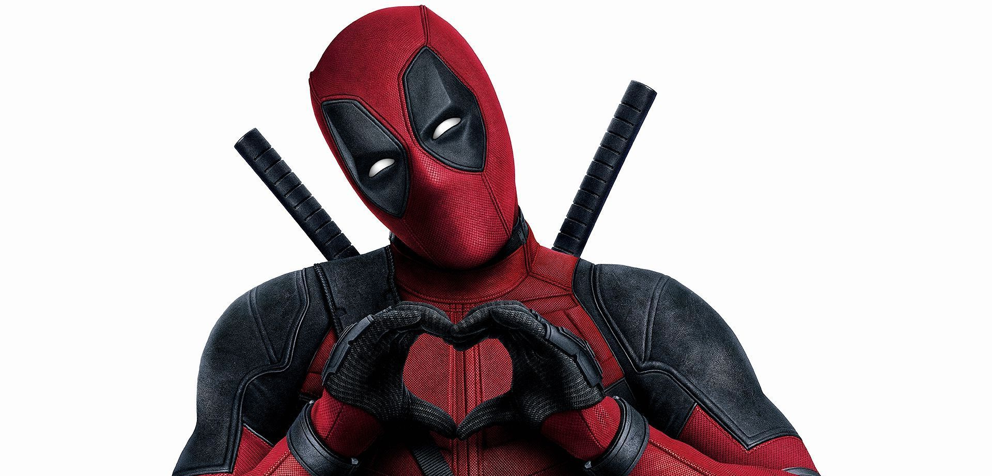
Thank you

